Slide 1
GAGAN GUDAPATI
CAPSTONE PROJECT
NGA PRESKILLING TRAINING PROGRAM

Slide 2
Introduction
I’m Gagan Gudapati, and I’m from Vijayawada, Andhra Pradesh. I did my Bachelor of Technology in ECE stream from ALIET. Worked as a Marketing Manager for a couple of months in Hyderabad. Later resigned and enrolled myself into Embedded C programming course where I got trained through the concepts of Embedded C, Linux, TCP/IP Socket programming, ARM.

Slide 3
Contents
Objective
About the application
Module 1 - Automated Testing with Selenium
Module 2 - Manual Testing
Module 3 - Behavior-Driven Development (BDD) with Cucumber

Slide 4
Objective:
This project includes three modules:
Automation Testing: To develop an automated testing suite using Selenium that ensures the West Florida AHEC website functions as expected, providing a seamless user experience. This includes validating key features such as navigation, form submissions, and cross-browser compatibility while integrating ExtentReports tool for detailed test execution insights.
Manual Testing: To thoroughly validate the user interface and core functionalities of the website through manual testing, ensuring usability and correctness. This module also focuses on exploratory testing to uncover edge cases and usability issues that may not be detected through automation, documenting all findings using tools like Jira.
BDD with Cucumber: To implement Behavior-Driven Development (BDD) for defining, automating, and validating user-centric test scenarios using Gherkin syntax.

Slide 5

About West Florida AHEC healthcare website
West Florida AHEC (Area Health Education Center) is a healthcare-focused organization dedicated to improving access to quality healthcare services and promoting health education in the community. Their website serves as a hub for resources, programs, and support tailored to meet the needs of both healthcare providers and residents across West Florida.
Through the site, users can find information on local healthcare services, educational initiatives, training programs for healthcare professionals, and community events that aim to enhance public health awareness. It also features tools like "Find Local Help" to connect individuals with healthcare resources near them, ensuring comprehensive support for a healthier community.

Slide 6
Module 1: Automated Testing with Selenium
Approach:
Automated testing using TestNG to verify the loading of key sections like the navigation menu, health programs, and resource links. Tested the functionality of the search bar and links to health programs. Automated navigation through different programs and ensured content display. Implemented user registration, login, and password recovery, and generated detailed reports with ExtentReports.
To set up the environment, the following requirements are needed:
Eclipse IDE: Used for writing and managing the test scripts in java
Maven: For managing dependencies.
Selenium WebDriver: For browser automation.
TestNG framework: Facilitated managing test cases, annotations, and reporting.
ExtentReports: Integrate ExtentReports for test result of the automation testing

Slide 7
Approach (Cont.)
Test Scenarios:
Navigation Menu: Validate that all menu options like Home, About, Programs, etc., lead to the correct pages.
Search Functionality: Ensure the search bar correctly processes queries and navigates to the result page.
Login/Registration: Automate user login and registration forms with valid credentials and verify success.
Forgot Password: Test password recovery functionality.
Key Features:
Dynamic Interaction: Uses WebDriver's Actions class to interact with dynamic elements.
Data-Driven Testing: Utilizes TestNG's DataProvider for login and registration tests with multiple test data sets.
Screenshot Capture: Captures screenshots of the pages to verify UI elements and help with debugging.
Cross-Browser Testing: Supports testing on different browsers like Chrome and Firefox.

Slide 8
Challenges
Stale Element Reference Exception: Occurs when an element is no longer attached to the DOM, especially when navigating back or refreshing the page.
Page Loading Delays:Pages sometimes took longer to load due to heavy content or network issues.
Dynamic Menus and Submenus: Navigation required handling hover actions and dynamically loaded elements.
Version Compatibility in POM File: Issue with version compatibility in my project dependencies.
Troubleshooting Strategies
Handling Stale Element Exception: Re-located elements dynamically before interacting again.
Mitigating Page Load Delays: Utilized Explicit Waits and conditional checks for element visibility.
Dynamic Element Handling: Used Actions class for smooth hover interactions.

Slide 9
Automation Integration Using JENKINS
PIPELINE JENKINS:
- Configured to trigger tests upon code commits.
- Scheduled nightly builds for regression testing.
OUTCOMES:
- Continuous Integration for faster feedback.
- Automated build and deployment process.
- And access it via http://localhost:8080

Slide 10
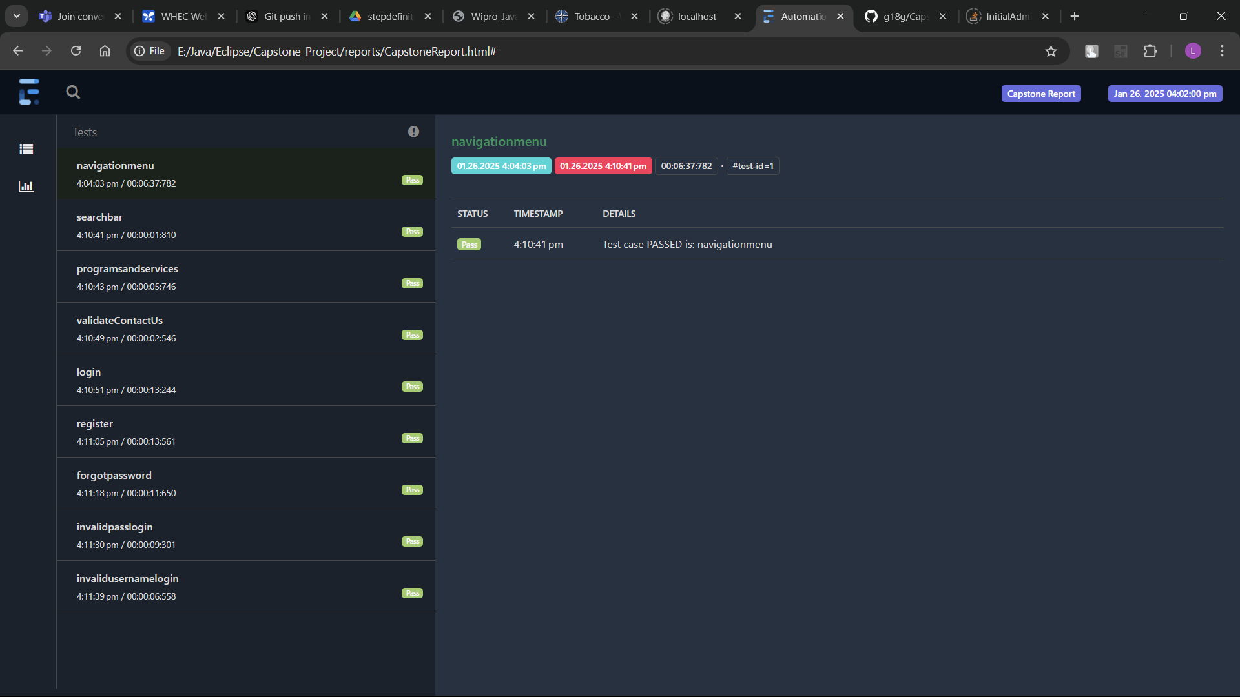
Test Results

Slide 11
Module II: Manual Testing
Approach:
Understand the functionalities of the website (homepage, navigation menu, search bar, account-related features, etc.). Identify critical areas to test (e.g., navigation flow, login, registration, and contact forms).
To set up the environment, the following requirements are needed:
Test Case Development: Developed detailed test cases based on the requirements.
Excel Sheets: to document the steps for each test case, and also to include other information.
Web Browsers: Used Google Chrome and Firefox to manually perform the steps, and also to verify expected behavior.

Slide 12
Approach (Cont.)
Test Case Design:
Home Page
Navigation: Verify links redirect correctly.
Search: Test valid, invalid, and empty inputs.
Health Programs Display: Check layout, alignment, and responsiveness.
Program Details Pages
Content Accuracy: Ensure all program details are correct and complete.
Links & Buttons: Verify external redirects.
Cross-Browser/Device: Validate consistency.
Forms and Submissions
Field Validations: Test valid, invalid, and missing inputs.
Error Messages: Check clarity and accuracy.
Successful Submission: Ensure confirmation displays correctly
User Account Management
Account Creation: Test valid and invalid user registrations.
Login: Verify valid/invalid credentials, locked accounts.
Forgot Password: Verifying the option.

Slide 13
Defects
Facebook Icon Issue (D_01): Clicking on the Facebook icon does not open the Facebook page in a new tab, resulting in the page failing to load.
Email Field Error (D_02): The form allows submission even when the "Email" field is left empty, without displaying an error message to the user.
Privacy Policy Page Issue (D_03): Clicking on the Privacy Policy hyperlink leads to a "Page Not Found" error instead of opening the privacy policy page.

Slide 14
Integration with Jira
PURPOSE -To ensure the functionality and usability of critical modules through manual testing
ISSUE TRACKING:
- Logged bugs with priority levels
- Tracking of bug lifecycle for proper resolution
REPORTING
- Used dashboards for test progress monitoring.
- Shared real-time updates with the team

Slide 15
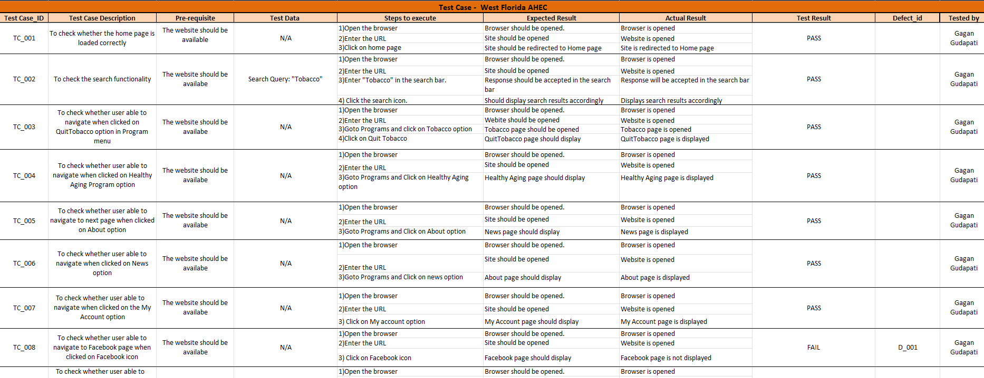
Reports
Test Cases

Slide 16
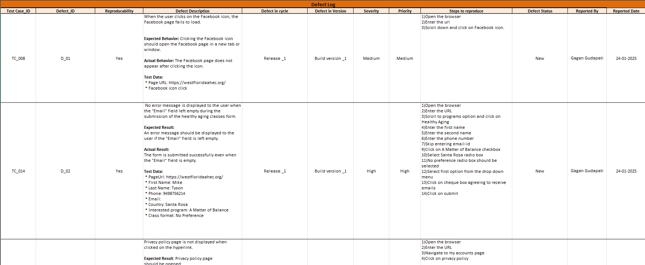
Reports
Defect log

Slide 17
Module III: Selenium with BDD Cucumber
Approach:
Utilized Selenium with BDD Cucumber to automate testing of the West Florida AHEC website functions, enhancing test readability and maintainability.
To set up the environment, the following requirements are needed:
Eclipse IDE: Used for writing and managing the test scripts in java
Maven: For managing dependencies.
Selenium WebDriver: For browser automation.
Cucumber: Facilitated BDD framework integration.
Gherkin: Gherkin syntax to define clear, behavior-driven test scenarios.

Slide 18
Approach (Cont.)
Test Scenarios:
Navigation & Health Program Access: Steps to test navigation to different health programs and verify content accuracy.
Form Submissions: Validate proper form functioning, including form validation and successful submissions.
User Account Management: Test registration, login and forgot password scenarios.
Key Features:
Developed feature files using Gherkin syntax to define clear, behavior-driven test scenarios.
Implemented step definitions to link Gherkin steps with Selenium actions.
Constructed a runner class for seamless test execution.

Slide 19
Challenges
Developing Reusable and Maintainable Step Definitions: Writing step definitions that are both reusable and maintainable can be tricky, and needs careful thought
Parameterization and Data Handling: Duplicate data during registration may occur due to repeated test executions.
Stale Element Reference Exception: Occurs when an element is no longer attached to the DOM, especially when navigating back or refreshing the page.
Dynamic Menus and Submenus: Navigation required handling hover actions and dynamically loaded elements.
Troubleshooting Strategies
Handling Stale Element Exception: Re-located elements dynamically before interacting again.
Dynamic Element Handling: Used Actions class for smooth hover interactions.
Reusable Step Definitions: Write generic step definitions using regular expressions to cover multiple scenarios.

Slide 20
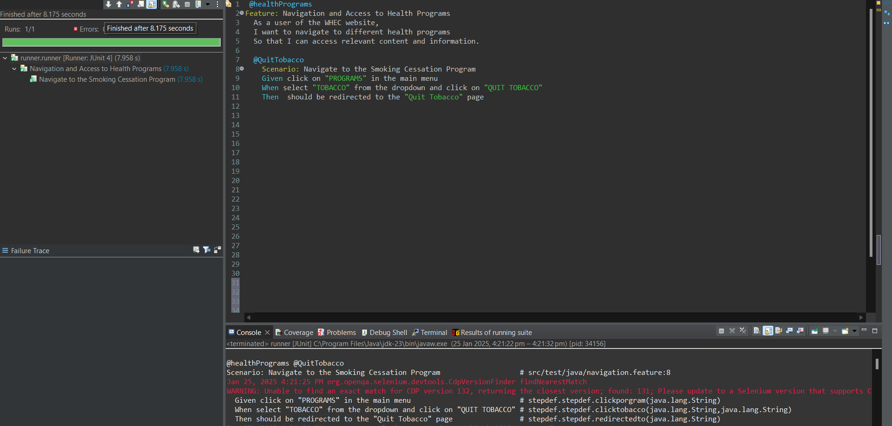
Test Results:
Navigation To Quit Tobacco page

Slide 21
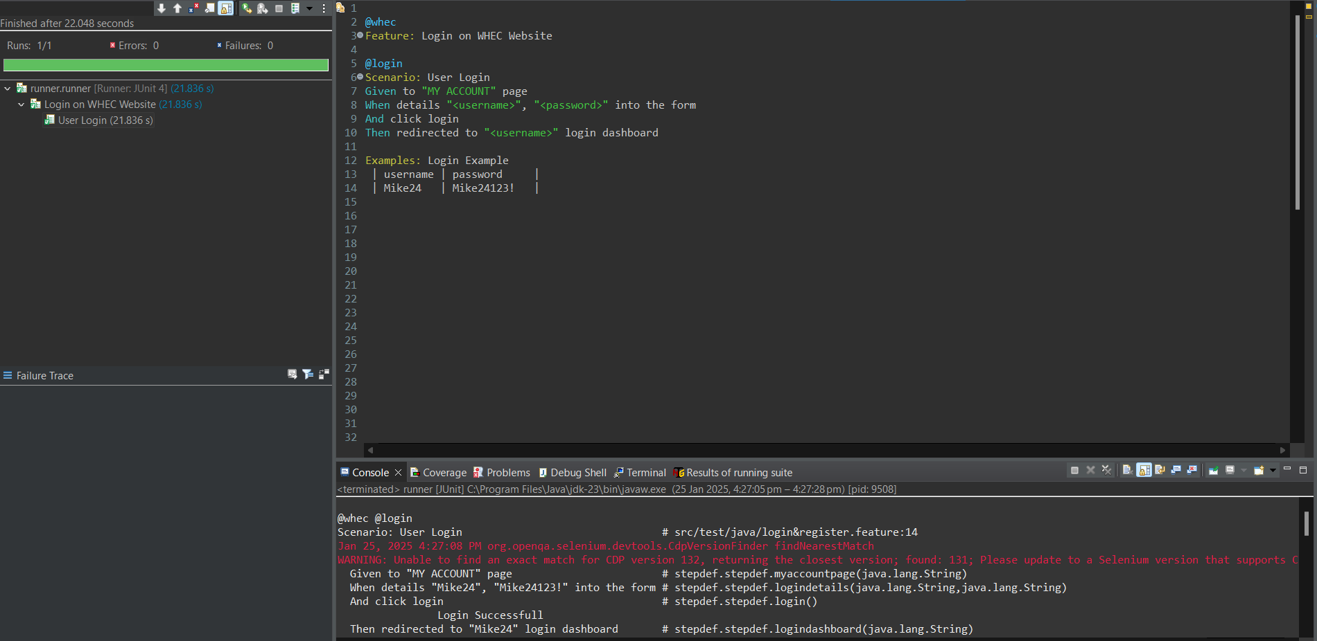
Test Results:
Logging in

Slide 22
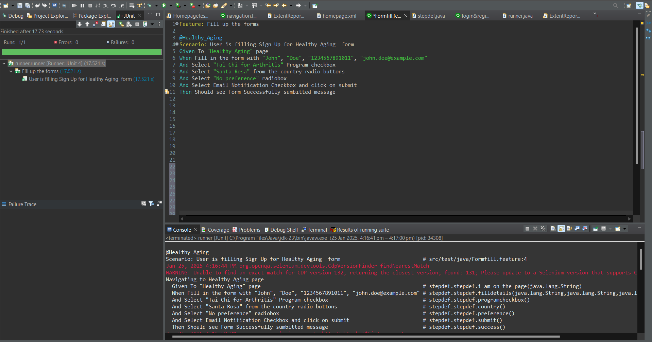
Test Results:
Form fill in Healthy Aging page

Slide 23
Conclusion:
This project successfully tested and validated the West Florida AHEC healthcare website for functionality, reliability, and user experience.
By leveraging automation testing with Selenium, manual testing techniques, and behavior-driven development using Cucumber, we ensured comprehensive test coverage. Key functionalities such as navigation, form submissions, and user account management were automated with detailed reports generated through ExtentReports.
Manual testing helped identify and address usability issues, while Gherkin-based scenarios in Cucumber ensured a structured approach.
The project enhanced website reliability, improved user experience, and ensured cross-browser compatibility, laying a strong foundation for future improvements like API testing and performance validation.

Slide 24


